Slide 1


Department of Electronics and Communication Engineering
VLSI Design
COURSE CODE
Topic:
Introduction to IC Technology
Session - 1

Slide 2



AIM OF THE SESSION
To familiarize students with the basic concept of IC Technology
INSTRUCTIONAL OBJECTIVES
This Session is designed to:
Demonstrate the various phases of development of IC Technology
Describe the history of IC Technology.
LEARNING OUTCOMES
At the end of this session, you should be able to:
Define IC Technology
Describe the various phases of development of IC Technology.
Summarize The IC Era and Future Perspective.

Slide 3
Background of IC Technology
The development of electronics endless with invention of vacuum tubes and associated electronic circuits.
This activity termed as vacuum tube electronics,
Afterward, the evolution of solid-state devices and consequent development of integrated circuits are responsible for the present status of communication, computing and instrumentation.
• The first vacuum tube diode was invented by John Ambrose Fleming in 1904.
• The vacuum triode was invented by Lee de forest in 1906.
Solid-State Device has a vast history. The birth history of semiconductors can be traced back to the invention of the rectifier (AC-DC converter) in 1874.
Decades later, Bardeen and Brattain at Bell Laboratories in the US invented the point-contact transistor in 1947, and Shockley invented the junction transistor in 1948.
This heralded the arrival of the transistor era. In 1946, the University of Pennsylvania in the US built a computer using the vacuum tubes. The computer was so large that its vacuum tubes occupied the entire building, and it consumed a huge amount of electricity and produced a lot of heat. Later, the innovative transistor calculator (computer) was developed, and since then computers have grown by leaps and bounds.
In 1956, the Nobel Prize in Physics was awarded jointly to Shockley, Bardeen and Brattain for their contribution to transistor research and the development of the transistor.

Slide 4
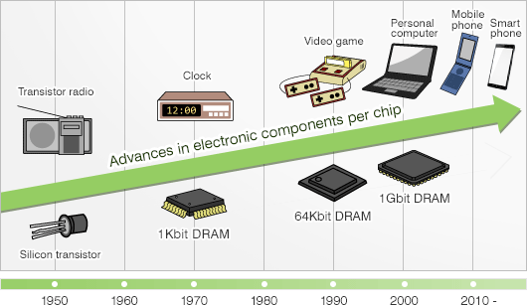
Various Phase of ICs Development
The semiconductor industry grew rapidly following the invention of the transistor. In 1957, it already exceeded the scale of 100 million dollars. In 1959, the bipolar integrated circuit (IC) was invented by Kilby of Texas Instruments and Noyce of Fairchild Semiconductor in the US. This invention had a major impact on the history of semiconductors, and it marked the dawn of the IC era. Being small and light in weight, the IC was widely used in a variety of electric appliances.
In 1967, Texas Instruments developed the electronic desktop calculator (the calculator) using IC. In Japan, electronic equipment manufacturers released calculators one after another, and fierce “calculator wars” continued until the end of the 1970s. IC integration advanced even further, and the large-scale integrated circuit (LSI) was developed.
The technologies continue to advance. The VLSI (from 100 thousand to 10 million electronic components per chip) was developed in the 1980s, and the ULSI (more than 10 million electronic components per chip) was developed in the 1990s. In the 2000s, the system LSI (a multifunction LSI with multiple functions integrated in a single chip) was put into full-scale production. As IC progresses toward high performance and multiple functions, its field of application is expanding broadly. Semiconductor are now used in every corner of our society and support everyday life.

Slide 5
IC Technology
The integration of large numbers of tiny transistors into a small chip was an enormous improvement
-Over the manual assembly of circuits using electronic components.
The integrated circuits mass production capability,
-Reliability, and
-Building-block approach to circuit design ensured the rapid adoption of standardized ICs in place of designs using discrete transistors.
An integrated circuit (IC) is a small semiconductor-based electronic device consisting of fabricated transistors, resistors and capacitors.
-Integrated circuits are the building blocks of most electronic devices and equipment.
An integrated circuit is also known as a chip or microchip.
-There are two main advantages of ICs over discrete circuits: cost and performance.

Slide 6
IC Technology
Low Cost and Scalable Technology
Because the chips, with all their components, are printed as a unit by photolithography
Rather than being constructed one transistor at a time.
Furthermore,
Much less material is used to construct a packaged IC die than a discrete circuit.
Performance is high
Since the components switch quickly and consume little power (compared to their discrete counterparts)
Because the components are small and positioned close together.
As of 2006,
Chip areas range from a few square millimeters to around 350 mm2, with up to 1 million transistors per mm.
and Assume for 2021

Slide 7
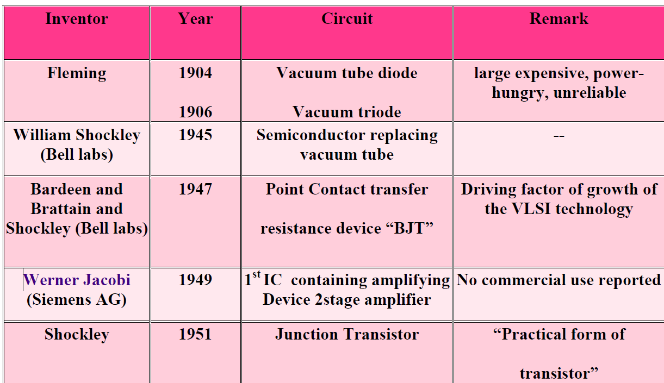
IMPORTANT FACTS RELATED TO THE IC Invention

Slide 8
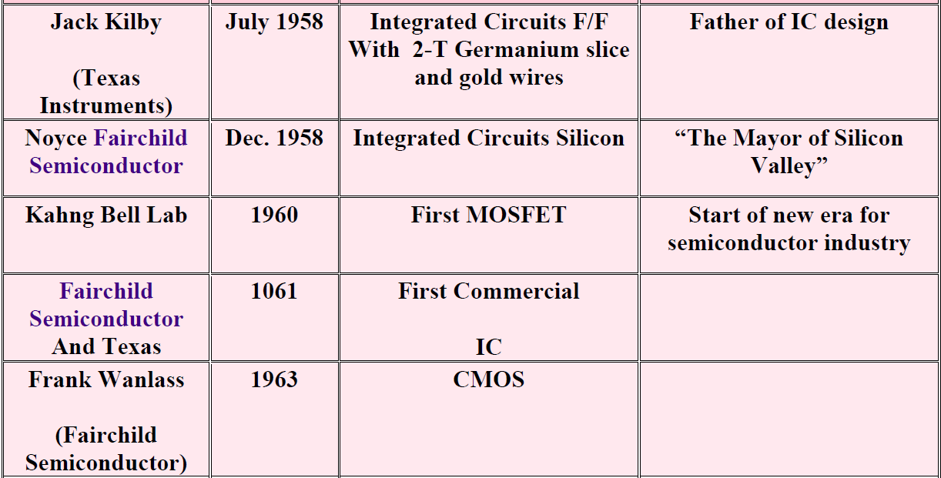
IMPORTANT FACTS RELATED TO THE IC Invention

Slide 9

IC Invention
Moore’s Law:
• Gordon E. Moore - Chairman Emeritus of Intel Corporation
• 1965 - observed trends in industry - of transistors on ICs vs release dates
• Noticed number of transistors doubling with release of each new IC generation
• Release dates (separate generations) were all 18-24 months apart
“The number of transistors on an integrated circuit will double every 18 months”
The level of integration of silicon technology as measured in terms of number of devices per IC Semiconductor industry has followed this prediction with surprising accuracy.
IC Technology:
• Speed / Power performance of available technologies
• The microelectronics evolution
• SIA Roadmap
• Semiconductor Manufacturers 2001 Ranking

Slide 10
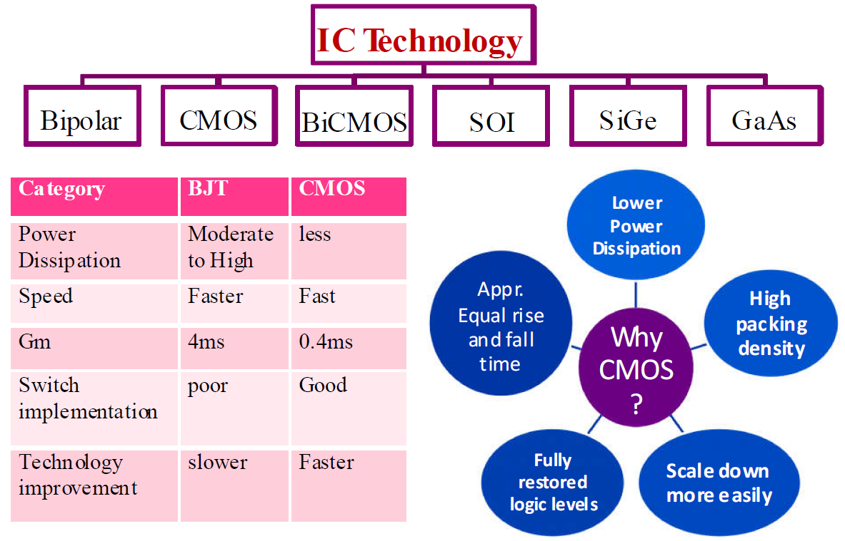
Circuit Technology

Slide 11
Scale of Integration
Small scale integration(SSI) --1960
The technology was developed by integrating the number of transistors of 1-100 on a single chip.
Ex: Gates, flip-flops, op-amps.
Medium scale integration(MSI) --1967
The technology was developed by integrating the number of transistors of 100- 1000 on a single chip.
Ex: Counters, MUX, adders, 4-bit microprocessors.
Large scale integration(LSI) –1972
The technology was developed by integrating the number of transistors of 1000- 10000 on a single chip.
Ex:8-bit microprocessors, ROM, RAM.
Very large scale integration(VLSI) -1978
The technology was developed by integrating the number of transistors of 10000- 1Million on a single chip. Ex:16-32 bit microprocessors, peripherals, complimentary high MOS.

Slide 12
Scale of Integration
Ultra large-scale integration(ULSI)
The technology was developed by integrating the number of transistors of 1Million- 10 Millions on a single chip.
Ex: special purpose processors.
Giant scale integration(GSI)
The technology was developed by integrating the number of transistors of above 10 Millions on a single chip.
Ex: Embedded system, system on chip.
Fabrication technology has advanced to the point that we can put a complete system on a single chip.
Single chip computer can include a CPU, bus, I/O devices and memory.
This reduces the manufacturing cost than the equivalent board level system with higher performance and lower power.

Slide 13
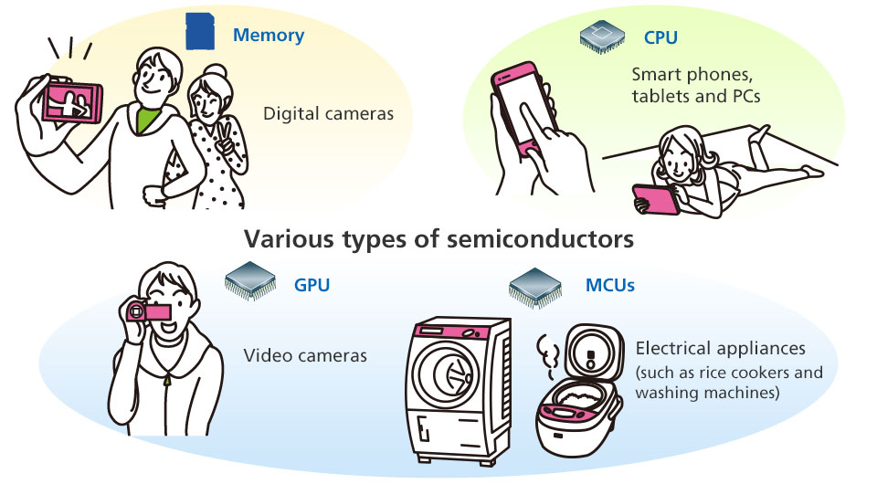
EXAMPLES of IC Technology Uses in Our Daily Life

Slide 14
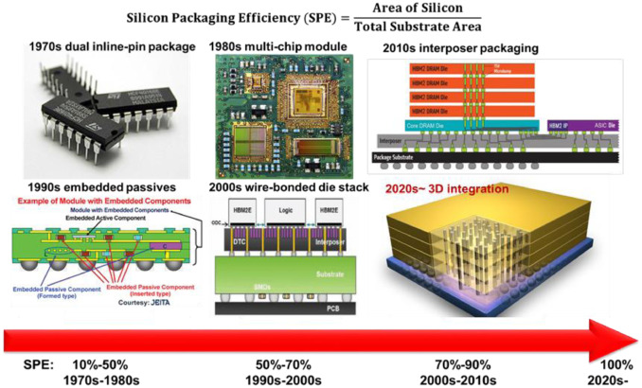
SUMMARY
The rigorous effort of various scientist has made possible the today’s IC Technology Advancement.
It has been a roller-costar journey of IC Technology since 1874 until now. Many has contributed to reach the achievement of present era modern ICs and Based Devices Such as-

Slide 15
SELF-ASSESSMENT QUESTIONS
1. The First Ever Semiconductor Device..
Transistor
MOSFET
AC-DC Converter
Resistor
IC Technology Embedded Device in your surroundings..
Cell Phone
Televisions
Computers
All Above

Slide 16
TERMINAL QUESTIONS
1. Describe the importance of IC Innovation in Modern Era.
2. List out the device used by you based on IC Technology.
3. Analyze the major event during the development of IC Technology.
4. Summarize the various development stages of IC Technology.

Slide 17
REFERENCES FOR FURTHER LEARNING OF THE SESSION
Reference Books:
1. Sung-Mo Kong, Yusuf Leblebici, “CMOS Digital Integrated Circuits Analysis and Design” Third Edition.
2. Debaprasad Das, “CMOS DESIGN” Second Edition.
Sites and Web links:
1. https://www.hitachi-hightech.com/global/en/knowledge/semiconductor/room/about/history.html (Dated 14-11-2022)

Slide 18
THANK YOU
Team – VLSI DESIGN

